Slide 1
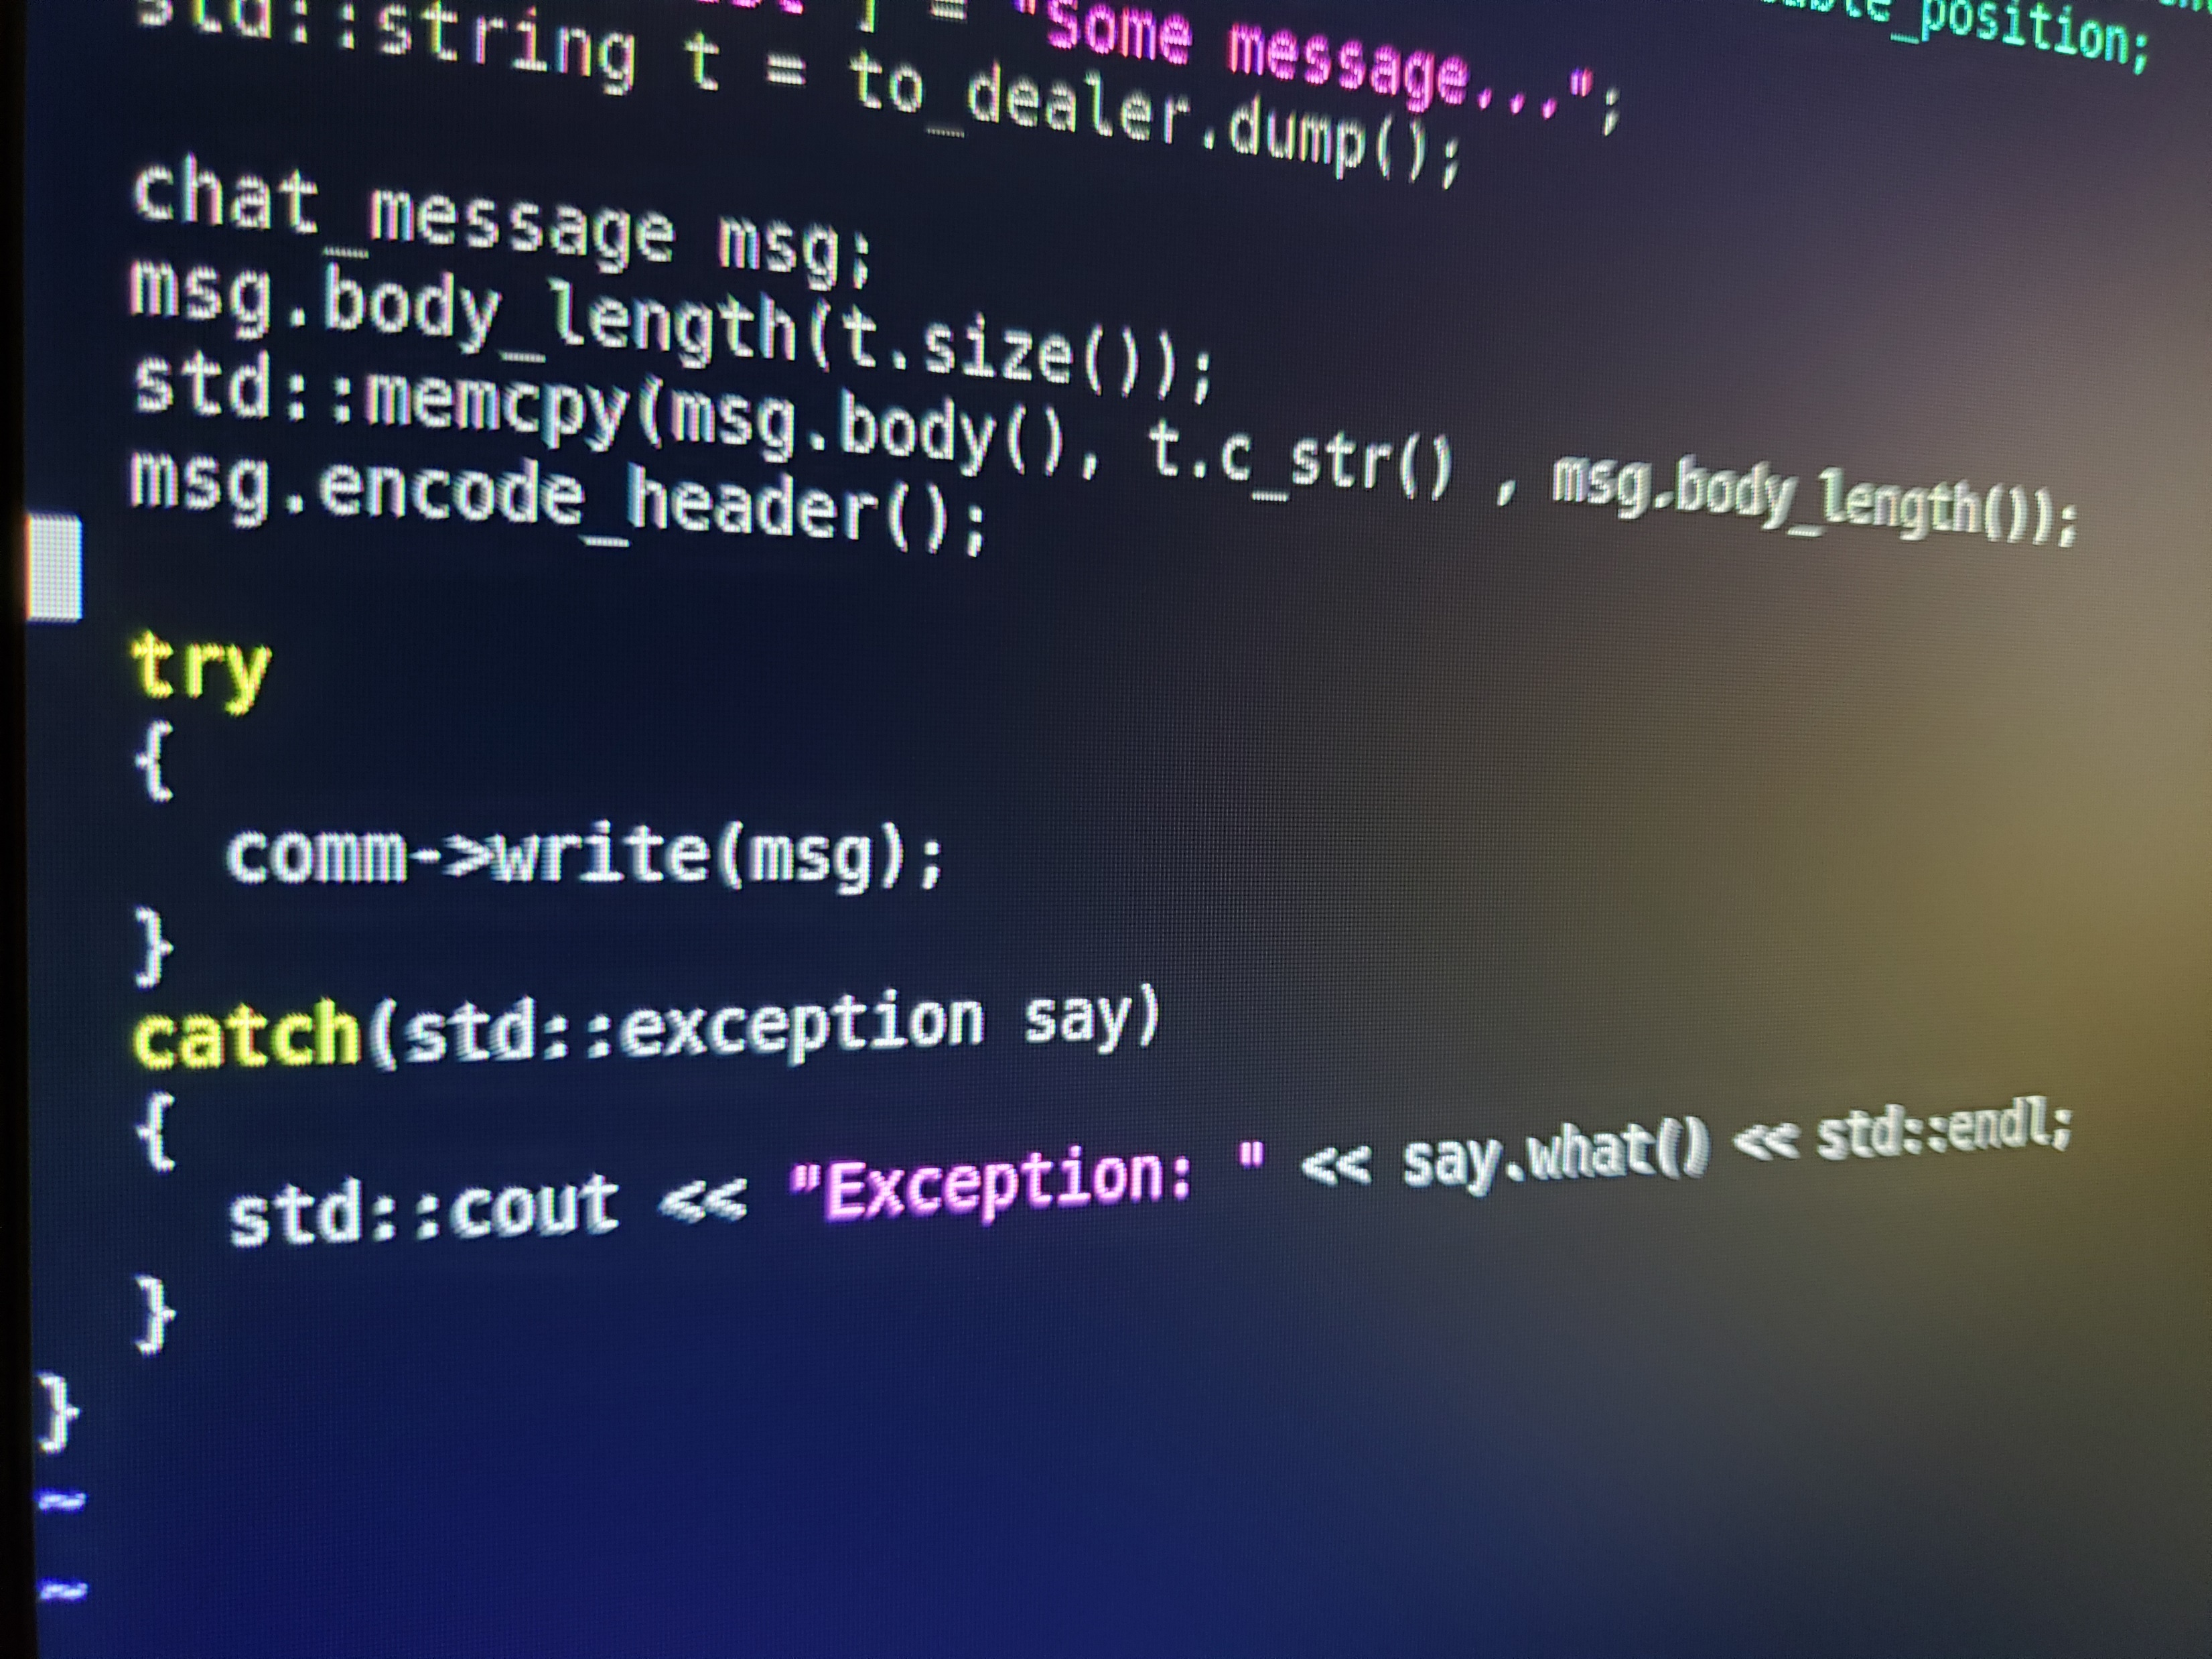
Project Summary Report
Group 002-5

Slide 4
Group Dynamics:
Communication via GroupMe and GitHub
Communication suffered after COVID-19
Moderate balance of skills
Occasional disagreements about where code should be headed
…need more stuff here

Slide 5
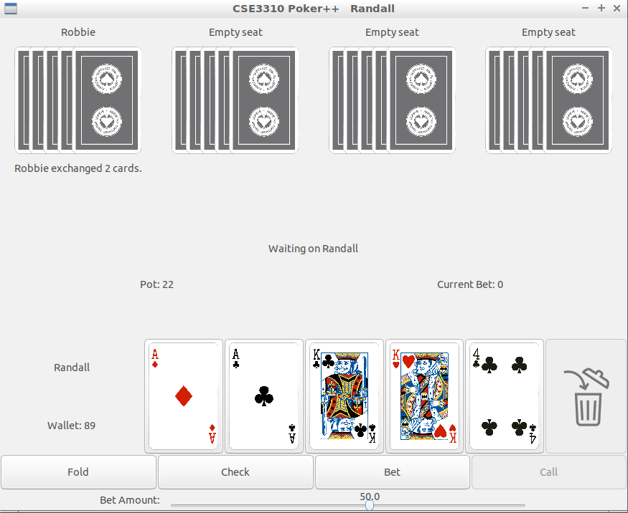
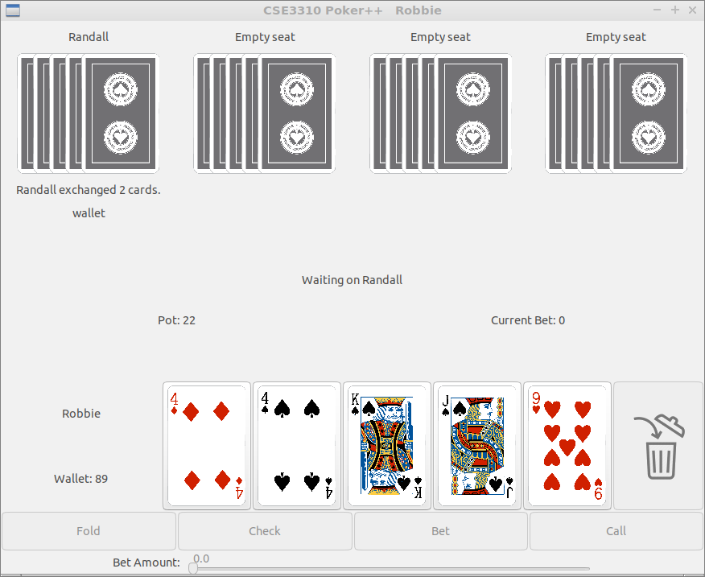
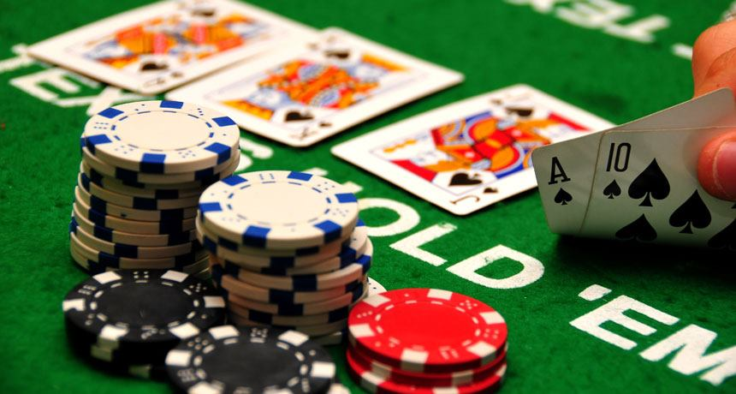
Gameplay of two separate clients

Slide 6
Randall Ferree
Interesting parts: working with others who come from different engineering backgrounds and perspectives.
Difficult parts: also the most difficult parts is working with others who come from those different perspectives. Sometimes we provide each other with good points and other times we can’t see eye to eye on things on what we believe is the best path.
Skills: better communication, negotiating, and planning

